Slide 1

Time Series Forecasting
By Abdallah Dar

Slide 2
ABSTRACT
We used data expected to have trend and seasonal components and divided it into two samples. We performed linear regression on one sample using variables trend and seasonality. We generated two models and used them to forecast the values of the second sample. Performance measures such as RMSE and MAE were used to judge the forecast we performed.

Slide 3
INTRODUCTION
Forecasting future data for variables is a difficult process made even more tricky by the addition of trend and seasonality in the data. That is why it is imperative to create models that takes into account these variables when predicting future values. We intend to fit linear models to time series data and use predictor variables trend and trend, season to form two separate models. We will then observe whether these variables completely account for the trend and seasonality in the data, since the more they account for it, the better their predictive ability. We will further use forecast performance measures to choose the better model since that model will be best suited to predict future values.

Slide 4


DATA
When forecasting we break our data into two parts:
Training Sample $\left\{y_{1},…,y_{T}\right\}$
Testing Sample $\left\{y_{T+1},…,y_{T+H}\right\}$
We use the training sample to build the model and use the model to forecast the testing sample.

Slide 5


DATA In R
We used data.world to retrieve monthly car sales in Quebec 1960-1968. We used data on sales since we expect it to have a strong trend and seasonal component present in it.
1. We convert the csv file to readable data in R.
Sales <-read.csv('monthly-car-sales-in-quebec-1960.csv’)
2. We convert are data into time series format using ts function.
The ts function is ts(Data$Variable, frequency= 12 for monthly, 4 for quarterly, 1 for annual, start=c(Year, Month))
Sales_ts <- ts(Sales$Monthly.car.sales.in.Quebec.1960.1968,frequency = 12, start = c(1960,01))
3. We then divide the data into the training and testing sample using the window function. We chose testing sample to have 24 months, hence the H mentioned in the previous slide would be H=24 for this case.
The window function is window(TS Data, start=c(Year, Month),end= c(Year, Month))
training <- window(Sales_ts, start=c(1960,01), end=c(1966, 12))
test <- window(Sales_ts, start=c(1967, 1), end=c(1968, 12))

Slide 6

MODEL
Trend is the increasing or decreasing value in the series. It is a function of time.
Linear trend is $f\left(t,β_{i}\right)=β_{0}+β_{1}t$
Seasonality is the repeating short-term cycle in the series.
We use dummy variables. A dummy variable is a variable that takes value of 1 or 0.
Seasonal Dummies: $D_{it}=\left\{\begin{aligned}1 if Quarter i where i=1,2,3,4 \\ 0 otherwise\end{aligned}\right.$
We generate a time series linear model using these variables to account for seasonality and or trend present in our data.

Slide 7

MODEL In R
We develop two models, one that has trend as the predictor variable and one that has trend and season as the predictor variables. We will use the training sample data to produce these linear models.
We will generate this using the Time Series Linear Model tslm function which is an extension of lm except that it allows variable trend and season which are created from the time series characteristic of the data. The variable trend is a simple time trend and season is a factor indicating the season.
1. tslm(TS data ~ trend)
model1 <-tslm(training ~ trend)
2. tslm(TS data ~ trend+season)
model2 <- tslm(training ~ trend + season)

Slide 8
Summary Output Model 1
This shows us that the data has a positive trend since trend estimate is 97.05. This value is also significant since p<0.05.
tslm(formula = training ~ trend)
Residuals:
Min 1Q Median 3Q Max
-7302 -2442 -1037 3010 8418
Coefficients:
Estimate Std. Error t value Pr(>|t|)
(Intercept) 9667.82 808.30 11.961 < 2e-16 ***
trend 97.05 16.52 5.875 8.74e-08 ***
---
Signif. codes: 0 ‘***’ 0.001 ‘**’ 0.01 ‘*’ 0.05 ‘.’ 0.1 ‘ ’ 1
Residual standard error: 3671 on 82 degrees of freedom
Multiple R-squared: 0.2962, Adjusted R-squared: 0.2876
F-statistic: 34.51 on 1 and 82 DF, p-value: 8.738e-08

Slide 9
Summary Output Model 2
Call:
tslm(formula = training ~ trend + season)
Residuals:
Min 1Q Median 3Q Max
-2716.57 -770.73 30.95 977.23 2455.19
Coefficients:
Estimate Std. Error t value Pr(>|t|)
(Intercept) 6535.044 524.787 12.453 < 2e-16 ***
trend 103.099 5.767 17.878 < 2e-16 ***
season2 719.901 678.069 1.062 0.29197
season3 5537.087 678.143 8.165 8.26e-12 ***
season4 8210.560 678.265 12.105 < 2e-16 ***
season5 8919.889 678.437 13.148 < 2e-16 ***
season6 6476.790 678.657 9.544 2.34e-14 ***
season7 2003.690 678.927 2.951 0.00429 **
season8 -492.694 679.245 -0.725 0.47062
season9 -2134.937 679.612 -3.141 0.00245 **
season10 2005.679 680.028 2.949 0.00431 **
season11 2809.008 680.492 4.128 9.84e-05 ***
season12 452.194 681.005 0.664 0.50883
---
Signif. codes: 0 ‘***’ 0.001 ‘**’ 0.01 ‘*’ 0.05 ‘.’ 0.1 ‘ ’ 1
Residual standard error: 1269 on 71 degrees of freedom
Multiple R-squared: 0.9272, Adjusted R-squared: 0.9149
F-statistic: 75.4 on 12 and 71 DF, p-value: < 2.2e-16
This shows us that the data has a positive trend since trend estimate is 103.099. This value is also significant since p<0.05.
It has seasons with negative and positive values and many seasons are significant.

Slide 10
PLOTS
We will use plots to get an idea of how well the models capture the seasonal component present in the data.
For this we will use ACF and PACF plots.
ACF: The autocorrelation function gives us the values of autocorrelation of any values in a series with its lagged values. In simple terms, it describes how well the present value is related to its past value. Time series has components such as trend and seasonality. This function considers them while finding correlations.
PACF: The partial autocorrelation function, instead of finding correlation of present values with lags as in ACF, finds correlations of a value with its lagged values after removing the effects of the lag which are explained by earlier lags.
If values cross the dashed lines in the plot, it means that specific lag is significantly correlated in the current series.

Slide 11
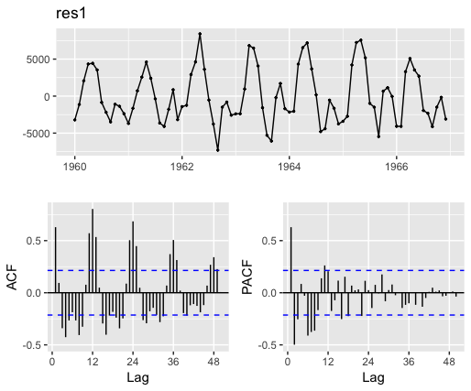
Plot Model 1 in R
res1 <- model1$residuals
ggtsdisplay(res1,lag.max=50)
Firstly, in the residual plot we notice a seasonal pattern that is followed each year.
Additionally, we notice significant values at lag 1,3,4,5,7,8,9,11,12 and many more points in ACF showing serial dependence.
The PACF also has various significant values.
This shows that this linear model of trend may not be good enough to model the original sequence.

Slide 12
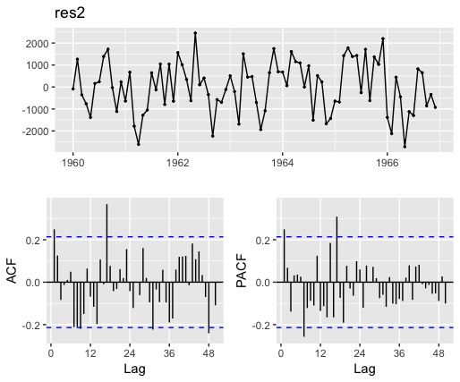
Plot Model 2 in R
res2 <- model2$residuals
ggtsdisplay(res2,lag.max=50)
Firstly, in the residual plot we notice less of a seasonal pattern than the residual plot of the first model
Additionally, we notice significant values at lag 1,17,48 in ACF showing much less serial dependence than the previous model.
The PACF also has significant values but again less than previous model.
This shows that this linear model of linear model while not the best, is comparatively better than the first model upon initial inspection.

Slide 13
FORECAST
We now attempt to forecast the values from Jan 1967 to December 1968. (The original values for these lie in the testing sample).
We will use model1 and model2 to forecast these values and will plot them for visual aid.
We expect model1 to form a straight line since it only has trend as the predictor variable. We expect model2 to more closely follow the original data as it also accounts for seasonality.

Slide 14
FORECASTING In R
We will use the forecast function in R to forecast the values in our testing sample.
The forecast function is forecast(model,h=length of testing sample/ number of values predicted)
We have already established that h=24.
Thus our code would be forecast(model, h=24)
Then we move onto plotting the forecasted model.

Slide 15
FORECASTING In R
1. We use the plot function to plot the forecasted model.
This produces a plot that has the training sample plotted in black and the forecasted values plotted in blue.
2. We use the lines function on the fitted values of the forecasted model to produce values of the training sample that would be forecasted by the model. We use the color red to denote this line.
3. We add a legend to the graph to make it easier to read. The legend function is legend(x coordinate for box’s starting point, y coordinate of box’s starting point, legend=c(“Label of first line”, ”label of second line”, ”label of third line”), col=c(“color of first line”, “color of second line”, “color of third line”, lty=line type which is 1 because we have a solid line, lwd=line width/thickness, title=“Line types or some other title”,cex=indicating amount by which text should be scaled to default where 1 is default, text.font= text fonts)

Slide 16
FORECASTING In R: CODE
fc1 <- forecast(model1, h=24)
plot(fc1)
lines(fc1$fitted, col="red")
legend(1959.75,28700, legend=c("Observed values of training sample", "Forecasted values of training sample", "Forecasted values for testing sample"),col=c("black", "red", "blue"),lty=1,lwd = 1 ,title="Line types",cex=0.7, text.font=3)
fc2 <- forecast(model2, h=24)
plot(fc2)
lines(fc2$fitted, col="red")
legend(1959.75,29000, legend=c("Observed values of training sample", "Forecasted values of training sample", "Forecasted values for testing sample"),col=c("black", "red", "blue"),lty=1,lwd=1 ,title="Line types",cex=0.7, text.font=4)

Slide 17
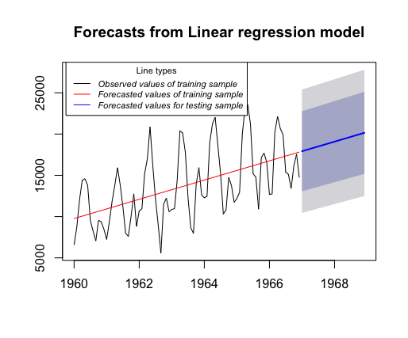
Forecast of Model 1
As expected, the forecasted values form a straight line and only account for the trend.
z

Slide 18
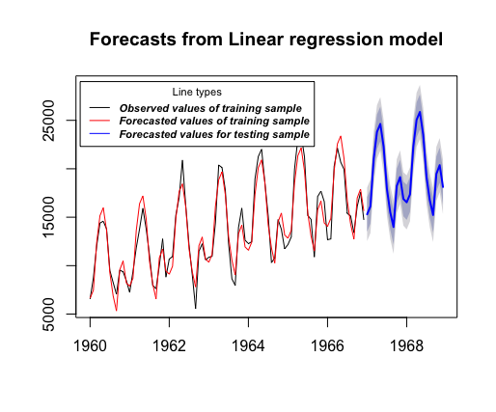
Forecast of Model 2
As expected, the forecasted model follows the actual data very closely since it account for both trend and seasonality. You would expect this forecasted model to be the better predictor of values in the testing sample.
z

Slide 19

PERFORMANCE MEASURES
While the plots do help us in hypothesizing which model would be better, we use performance measures to find the answer.
The forecasted values are compared to their corresponding values in the testing sample to calculate forecast errors.
$$e_{t+h}=y_{T+h}−{\hat{y}}_{T+h} ∀h=1,…,H$$
The performance measures we will use are the RMSE and MAE.

Slide 20

PERFORMANCE MEASURE: RMSE
The RMSE is the Root Mean Squared Error.
$$RMSE= \sqrt{\frac{1}{H}\sum_{h=1}^{H}{{e^{2}}_{T+h}}}$$

Slide 21

PERFORMANCE MEASURE: MAE
The MAE is the Mean Absolute Error.
$$MAE=\sum_{h=1}^{H}{\left|e_{T+h}\right|}$$

Slide 22

PERFORMANCE MEASURE IN R
1. We produce time series with 0 values that will be replaced by $e_{T+h} ∀h=1,…,24$
2. We produce $e_{T+h}$ using a for loop and finding the value $test\left[h\right]−model\$mean[h]$.
3. We modify the value to ${e^{2}}_{T+h}$ or $\left|e_{T+h}\right| using a for loop again.$
4. We find mean of $\left|e_{T+h}\right|$ for MAE and square root of mean of ${e^{2}}_{T+h}$ for RMSE.
Note: Each step on the next slide mirrors each step specified here.

Slide 23


PERFORMANCE MEASURE IN R: Model 1 Model 2
1. MeanSquaredError_f <- ts(0, frequency=12, start=c(1967, 1), end=c(1968, 12))
MeanAbsoluteError_f <- ts(0, frequency=12, start=c(1967, 1), end=c(1968, 12))
2. for ( h in 1:24){
MeanSquaredError_f[h]=test[h]-fc1$mean[h]
MeanAbsoluteError_f[h]=test[h]-fc1$mean[h] }
3$.$ for(h in 1:24){
MeanSquaredError_f[h]=(MeanSquaredError_f[h])^2
MeanAbsoluteError_f[h]=abs(MeanAbsoluteError_f[h]) }
4. RMSE <- sqrt(mean(MeanSquaredError_f))
MAE <- mean(MeanAbsoluteError_f)
1. MeanSquaredError_f2<- ts(0, frequency=12, start=c(1967, 1), end=c(1968, 12))
MeanAbsoluteError_f2<- ts(0, frequency=12, start=c(1967, 1), end=c(1968, 12))
2. for ( h in 1:24){
MeanSquaredError_f2[h]=test[h]-fc2$mean[h]
MeanAbsoluteError_f2[h]=test[h]-fc2$mean[h] }
3$.$ for(h in 1:24){
MeanSquaredError_f2[h]=(MeanSquaredError_f[h])^2
MeanAbsoluteError_f2[h]=abs(MeanAbsoluteError_f[h]) }
4. RMSE2 <- sqrt(mean(MeanSquaredError_f))
MAE2 <- mean(MeanAbsoluteError_f)
z

Slide 24
RESULTS
Model | RMSE | MAE
Model 1 | 4254.21 | 3844.37
Model 2 | 2552.60 | 2130.28
Better Model based on this performance measure? | Model 2 | Model 2
The better model is the one that has the lower value in each of the performance measures. Model 2 which accounts for trend and seasonality performs significantly better than Model 1 which only accounts for trend since it has lower RMSE and MAE values. This also matches our expectations and hypothesis.

Slide 25

DISCUSSION
This shows us that if data displays trend and seasonal components it is always significantly better predicted with models that account for both trend and seasonality. If our model only accounts for trend, it would be a poor predictor and would not be producing the desired results.

Slide 26
CITATIONS
https://robjhyndman.com/hyndsight/forecast7-part-2/
https://towardsdatascience.com/significance-of-acf-and-pacf-plots-in-time-series-analysis-2fa11a5d10a8?gi=cd7a267c7a08
http://www.datasciencemadesimple.com/add-legend-plot-legend-function-r/
https://towardsdatascience.com/trend-seasonality-moving-average-auto-regressive-model-my-journey-to-time-series-data-with-edc4c0c8284b
https://rpubs.com/Mentors_Ubiqum/tslm
https://data.world/perceptron/monthly-car-sales-quebec-1960/workspace/file?filename=monthly-car-sales-in-quebec-1960.csv
https://otexts.com/fpp2/accuracy.html
https://towardsdatascience.com/forecasting-with-r-trends-and-seasonality-def24280e71f
https://coolstatsblog.com/2013/08/11/how-to-use-autocorreation-function-acf-to-determine-seasonality/

